Slide 1
THEORY OF COMPUTATION
BCS503
Teaching Hours/Week (L:T:P:S) - 3:2:0:0 | CIE Marks - 50
Total Hours of Pedagogy - 50 | SEE Marks - 50
Credits - 04 | Total Marks - 100
Prof. N. Thanuja
Assistant Professor
Department of Computer Science & Engineering
Bangalore Institute of Technology
K. R. Road, V. V. Puram, Bengaluru-560004.

Slide 2
Assessment Details
(CIE and SEE)
Continuous Internal Evaluation (CIE) is 50%.
Minimum passing mark for the CIE is 40% of the maximum marks (20/50 marks).
Semester End Exam (SEE) is 50%.
Minimum passing mark for the SEE is 35% of the maximum marks (18/50 marks).
Minimum of 40% (40/100 marks)
CIE + SEE = 40/100

Slide 3
Continuous Internal Evaluation
CIE = Internal Assessment Test Component + Assignment
50 Marks = 25 Marks + 25 Marks
The first test will be administered after 40-50% of the syllabus has been covered.
The second test will be administered after 85-90% of the syllabus has been covered.
CIE marks will be based on a scaled-down sum of two tests and other methods of assessment.
Assignment 1 – Build different types of machines by using Open source tool JFLAP - 10 Marks.
Assignment 2 – RBTL 4 - 15 Marks.

Slide 4
Semester End Examination
Theory SEE will be conducted by University as per the scheduled timetable, with common question papers for the course (duration 03 hours).
The question paper will have ten questions.
Each question is set for 20 marks.
There will be 2 questions from each module.
Each of the two questions under a module (with a maximum of 3 sub-questions), should have a mix of topics under that module.
The students have to answer 5 full questions, selecting one full question from each module.
Marks scored shall be proportionally reduced to 50 marks..

Slide 5
Instructions
It’s a problematic subject.
More concentration is required in the class.
Maintain a separate note book for the subject to solve problems.
Be regular to the classes in order to understand the concepts clearly.
Practice is more important.
Study Materials will be available in Google sites.
(Notes, Recorded Videos, Previous year Question Papers, Lesson Plan and Previous year Internal Questions papers with answers)

Slide 6
Prerequisites
Data Structures and Applications (BCS304)
Discrete Mathematical Structures (BCS405A)
Google Sites
https://sites.google.com/view/nthanuja/home
Course Beginning Survey

Slide 7
Introduction
What is Automata Theory?
Study of Abstract Machines / Computing Devices.
What is an Abstract Machine?
  An Abstract Machine, also called an Abstract Computer, is a theoretical model of a computer hardware or software system used in automata theory.
A typical abstract machine consists of a definition in terms of input, output and the set of allowable operations used to turn the former into the later.

Slide 8
Automata play a major role in the following fields
Theory of computation
Compiler construction
Parsing
Artificial Intelligence
Formal Verification & Analyze the complexity of algorithms
The word automata (the plural of automaton) comes from the Greek word which means "self-making".

Slide 9
What is Language?
The method of human communication, either spoken or written, consisting of the use of words in a structured and conventional way.
What is Grammar?
The whole system and structure of a language or of languages in general, usually taken as consisting of syntax and semantics.

Slide 10
Syntax: It is the set of rules, principles, and processes that govern the structure of sentences in a given language, usually including word order.
OR
The arrangement of words and phrases to create well-formed sentences in a language.
Semantics: It is concerned with the relationship between signifiers like words, phrases, signs, and symbols.

Slide 11
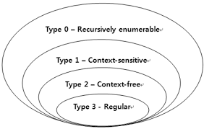
Chomsky Hierarchy
Chomsky hierarchy is a containment hierarchy of classes of formal grammars.
This hierarchy of grammars was described by Noam Chomsky in 1956.

Slide 12
DIFFERENNT TYPES OF GRAMMARS & LANGUAGES
TYPE 0 | Phrase Structured / Unrestricted Grammar | Recursively Enumerable Language | Turing Machines (TM) [Module 5\
TYPE 1 | Context Sensitive Grammar | Context Sensitive Language | Linear Bounded Automata (LBA)
TYPE 2 | Context Free Grammar (CFG) [Module 3 & 4] | Context Free Language (CFL) [Module 3 & 4] | Pushdown Automata (PDA) [Module 3]
TYPE 3 | Regular Grammar (RG) [Module 1 & 2] | Regular Language (RL) using Regular Expressions (RE) [Module 2] | Finite Automata (FA) [Module 1]

Slide 13
FINITE AUTOMATA MACHINES
DFA NFA ℇ-NFA
DFA Deterministic Finite Automata
NFA Non-Deterministic Finite Automata
ℇ-NFA Non-Deterministic Finite Automata with ℇ Transitions

Slide 14
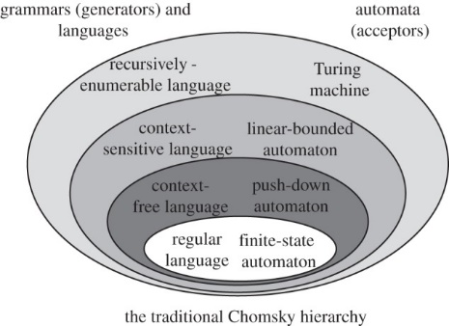

Slide 15
APPLICATIONS
Finite State Machines (FSM)
Parity Checkers
Building Security Devices
Vending Machines
Network Communication Protocols – Languages – HTML
Interactive Video Games (Pac-Man)
Traffic Lights

Slide 16
Text Parsing
CPU Controllers
Protocol Analysis (TCP)
Natural Language Processing
Speech Recognition
Finite State Machine and Context Free Grammars (FSM & CFG)
DNA Computations (Molecules, Proteins)

Slide 17
CFG : Used to document the languages syntax and they form the basis for the parsing techniques that all compilers use.
CFL
Natural Language Processing (NLP)
Language Translators
Build program to manage words and check grammars
Design and implementation of modern programming languages rely heavily on the theory of CFL’s.
Undecideability and Interactability : Used in Artificial Intelligence (AI)

Slide 18
SYLLABUS
MODULE – 1
Introduction to Finite Automata
Structural Representations
Automata and Complexity
The Central Concepts of Automata Theory
Deterministic Finite Automata
Nondeterministic Finite Automata
An Application: Text Search
Finite Automata with Epsilon-Transitions
TEXT BOOK: Sections 1.1, 1.5, 2.2, 2.3, 2.4, 2.5

Slide 19
Continued..
MODULE – 2
Regular Expressions
Finite Automata and Regular Expressions
Proving Languages not to be Regular
Closure Properties of Regular Languages
Equivalence and Minimization of Automata
Applications of Regular Expressions
TEXT BOOK: Sections 3.1, 3.2(Except 3.2.1), 3.3, 4.1, 4.2, 4.4

Slide 20
Continued..
MODULE – 3
Context-Free Grammars
Parse Trees
Ambiguity in Grammars and Languages
Ambiguity in Grammars and Languages
Definition of the Pushdown Automaton
The Languages of a PDA
Equivalence of PDA's and CFG's
Deterministic Pushdown Automata
TEXT BOOK: Sections 5.1, 5.2, 5.4, 6.1, 6.2, 6.3.1, 6.4

Slide 21
Continued..
MODULE – 4
Normal Forms for Context-Free Grammars
The Pumping Lemma for Context-Free Languages
Closure Properties of Context-Free Languages
TEXT BOOK: Sections 7.1, 7.2, 7.3

Slide 22
Continued..
MODULE – 5
Introduction to Turing Machines
Problems That Computers Cannot Solve
The Turing Machine
Programming Techniques for Turing Machines
Extensions to the Basic Turing Machine
Undecideability
A Language That Is Not Recursively Enumerable
TEXT BOOK: Sections 8.1, 8.2, 8.3, 8.4, 9.1, 9.2

Slide 23
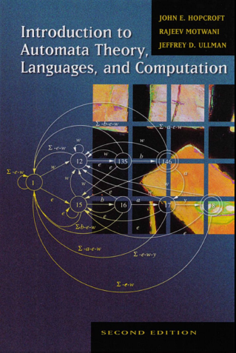
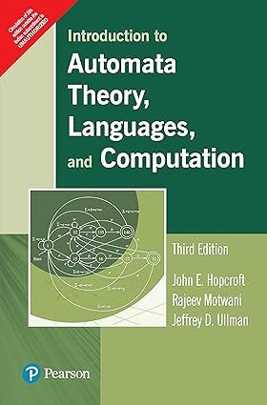
Text Books
John E. Hopcroft, Rajeev Motwani, Jeffrey D. Ullman,“ Introduction to Automata Theory, Languages and Computation”, Second Edition, Pearson.

Slide 24
REFERENCE BOOKS
Elain Rich, “Automata, Computability and Complexity”, 1st Edition, Pearson Education, 2018.
K. L. P. Mishra, N. Chandrashekaran , 3rd Edition , ‘Theory of Computer Science”, PHI, 2012.
Peter Linz, “An introduction to Formal Languages and Automata “, 3rd Edition, Narosa Publishers, 1998.
Michael Sipser, “Introduction to the Theory of Computation”, 3rd Edition, Cengage Learning, 2013.
John C. Martin, “Introduction to Languages and The Theory of Computation”, 3rd Edition, Tata McGraw - Hill Publishing Company Limited, 2013.

Slide 25
Web links and Video Lectures
(e-Resources)
https://archive.nptel.ac.in/courses/106/105/106105196/
https://archive.nptel.ac.in/courses/106/106/106106049/
https://nptelvideos.com/course.php?id=717

Slide 26
COURSE LEARNING OBJECTIVES
CLO1: Introduce core concepts in Automata and Theory of Computation.
CLO2: Identify different Formal Language Classes and their Relationships.
CLO3: Learn concepts of Grammars and Recognizers for different formal languages.
CLO4: Prove or disprove theorems in automata theory using their properties.
CLO5: Determine the decidability and intractability of Computational problems.

Slide 27
COURSE OUTCOMES
At the end of the course, the student will be able to
CO1: Apply the fundamentals of automata theory to write DFA, NFA, Epsilon-NFA and conversion between them.
CO2: Prove the properties of regular languages using regular expressions.
CO3: Build context-free grammars (CFGs) and pushdown automata (PDAs) for formal languages.
CO4: Construct Turing machines to solve the computational problems.
CO5: Explain the concepts of decidability and Undecideability.

Slide 28
SET THEORY
What is a SET?
A set is a collection of distinct elements.
All the elements of the set should be enclosed between { & } and separated by commas.
Example: The set of positive integers greater than 0 and less than or equal to 25 which are divisible by 5 can be represented as
S = { 5, 10, 15, 20, 25 }
The elements of a set can be in any order.

Slide 29
The previous representation is useful if the number of elements are less.
The set can also be represented by describing the properties of the elements if the number of elements are more.
S = { 5x | x is a positive integer where 0 < x ≤ 25}
Sets are denoted by capital letters.
Elements within the set are denoted by lower case letters.
What is Empty Set / Null Set?
A set which has no elements, denoted by { } or Ø .
Example: S = Ø or S = { }

Slide 30
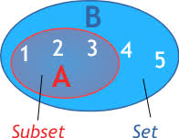
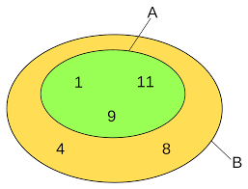
What is a Subset?
Set A is a subset of set B if every element
of set A is an element of set B, denoted by A ⊆ B.
What is Proper subset?
If A ⊆ B and B contains an element which is
not in A, then A is a Proper subset of B,
denoted by A ⊂ B.

Slide 31
When we say that two sets are equal?
The two sets A and B are same iff A ⊆ B and B ⊆ A.
Every element of set A is an element of set B and every element of set B is also an element of set A.
Example: A = { a, b, c } and B = { a, b, c } then A = B.
What is a Power set?
The set of all subsets of set A, denoted by 2^{A}.
Example: A = { 1, 2, 3 }
2^{A} = { {}, {1}, {2}, {3}, {1,2}, {1,3}, {2,3}, {1,2,3} }
|A| = 3, | 2^{A} | = 8

Slide 32
What is Cartesian Product or Cross Product of two sets?
The Cartesian product of A and B is given by
A × B = { (a,b) | a ∈ A and b ∈ B }, (a,b) is an ordered pair.
Example: A = { a, b, c } and B = { 0, 1 }
A × B = { (a,0), (a,1), (b,0), (b,1), (c,0), (c,1) }
A × B = 3 * 2 = 6

Slide 33
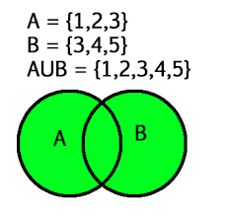
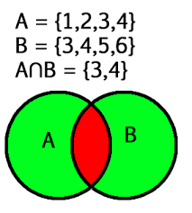
What is Union of two sets?
The Union of two sets A and B is given by
A ⋃ B = { x | x ∈ A or x ∈ B }
Example: A = { a, b, c } and B = { 0, 1 }
A ⋃ B = { a, b, c, 0, 1 }
What is Intersection of two sets?
The intersection of two sets A and B is given by
A ⋂ B = { x | x ∈ A and x ∈ B }
Example: A = { a, b, c } and B = { c, d, e }, A ⋂ B = { c }
Collection of common elements in both the sets A and B.

Slide 34
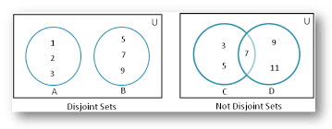
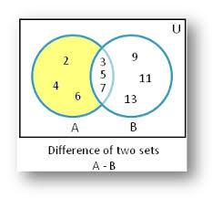
What is Disjoint Sets?
If two sets A and B have no common elements then the two sets are called Disjoint Sets.
Example: A = { a, b, c } and B = { 0,1 }
A ⋂ B= Ø
What is the difference of two sets?
The difference of two sets A and B is given by
A - B = { x | x ∈ A and x ∉ B }
Example: A = { a, b, c, d }and B = { a, d }, A-B = { b, c }

Slide 35
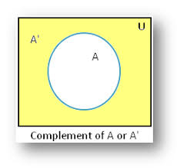
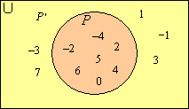
What is Complement of a set?
A set containing everything that is not in A, denoted by A^{c} OR A‘.
A‘ = U - A where U is the universal set.
A‘ = { x | x ∈ U and x ∉ A }
Example: U = { 1, 2, 3, 4, 5, 6 } and A = { 1, 2 }
A‘ = { 3, 4, 5, 6 }

Slide 36
MODULE - 1
Alphabet
An alphabet is a finite, nonempty set of symbols or characters.
It is denoted by the symbol ∑.
Example: English alphabet ∑ = { a, b, c, …., z }
Binary alphabet ∑ = { 0, 1 }

Slide 37
Strings
A string (or sometimes word) is a finite sequence, possibly empty, of symbols chosen from some alphabet.
Given any alphabet, the shortest string that can be formed from is the empty string, written as ℇ.
The empty string is the string with zero occurrence of symbols.
Example: English alphabet ∑ = { a, b, …., z } Strings are ℇ, a, b, ab, aaa, … Binary Alphabet ∑ = { 0, 1 } Strings are ℇ, 0, 00, 111, …..

Slide 38
FUNCTIONS ON STRINGS
Length of a String
The length of a string s, is the number of positions for symbols in the string (number of symbols in s), denoted as | s |.
Example: | ℇ | = 0 | 1001101 | = 7
For any symbol c and string s, the function #c(s) to be the number of times that the symbol occurs in s.
Example: #a(abbaaa) = 4

Slide 39
Power of an Alphabet
It is denoted by ∑^{k} , is the set of strings of length k, each of whose symbols is in ∑.
Example: ∑ = {a, b, c}
∑⁰ = {ℇ}
∑¹ = {a, b, c}
∑²= {aa, ab, ac, ba, bb, bc, ca, cb, cc}
∑³ = {aaa, aab, aac, aba, abb, abc, aca, acb, acc, baa, bab, bac, bba, bbb, bbc, bca, bcb, bcc, caa, cab, cac, cba, cbb, cbc, cca, ccb, ccc} and so on

Slide 40
The set of all possible strings over an alphabet ∑ is written as ∑*.
Example: ∑ = {0, 1} then ∑* = {ℇ, 0, 1, 00, 01, 10, 11, 000, ….}
        OR
        ∑* = ∑⁰ ⋃ ∑¹ ⋃ ∑² ⋃ ∑³ ⋃ …..
          The two variations of power of an alphabet are
          The set of nonempty strings from alphabet ∑ is denoted as ∑⁺
          ∑⁺ = ∑¹ ⋃ ∑² ⋃ ∑³ ⋃ ….. (Kleene Plus)
          ∑* = ∑⁺ ⋃{ℇ} (Kleene Closure)

Slide 41
Concatenation
Let x and y be strings. Then xy denotes the concatenation of x and y, that is, the string formed by making a copy of x and following it by a copy of y.
If x is the string composed of i symbols x = a₁a₂…a_{i} and y is the string composed of j symbols y = b₁b₂…b_{j}, then xy is the string of length i+j : xy = a₁a₂…a_{i}b₁b₂…b_{j}
Example: x=1101 and y = 0011 then
xy = 11010011 and yx = 00111101
The empty string, ℇ , is the identity for concatenation of strings.
So, ∀x ( xℇ = ℇx = x)
Concatenation, as a function defined on strings, is associative.
So, ∀s, t, w ((st)w = s(tw))

Slide 42
Language
A set of strings all of which are chosen from some ∑*, where ∑ is a particular alphabet, is called a language.
A Language is subset of ∑*, denoted by L ⊆ ∑*
Examples:
  The language of all strings consisting of n 0’s followed by n 1’s, for some n ≥ 0 : {ℇ, 01, 0011, 000111,….}
  L = {0^{n}1^{n} | n ≥ 0}

Slide 43
Examples:
  The set of strings of 0’s and 1’s with equal number of each : {ℇ, 01, 10, 0011, 1001, 1100, 0101,….}
  L = {w | w consists of an equal number of 0’s and 1’s}
  The set of binary numbers whose value is a prime: {10, 11, 101, 111, 1011,…}
  L = {w | w is a binary integer that is prime}
  A Language containing an empty string ℇ is denoted by L = {ℇ}
  An empty language is denoted by Ø, i.e., L = {} or Ø
  Ø ≠{ℇ}

Slide 44


